Slide 1
Pathway Collages
Suzanne Paley
Pathway Tools Workshop 2018

Slide 2
What is a Pathway Collage?
Web Application (but accessible from both web and desktop PTools)
User-specified set of Pathway Diagrams
Zoomable, Editable, Customizable
Generate High-Quality Images for Publications and Presentations
Overlay Omics Data
Implemented in JavaScript using Cytoscape.js

Slide 3
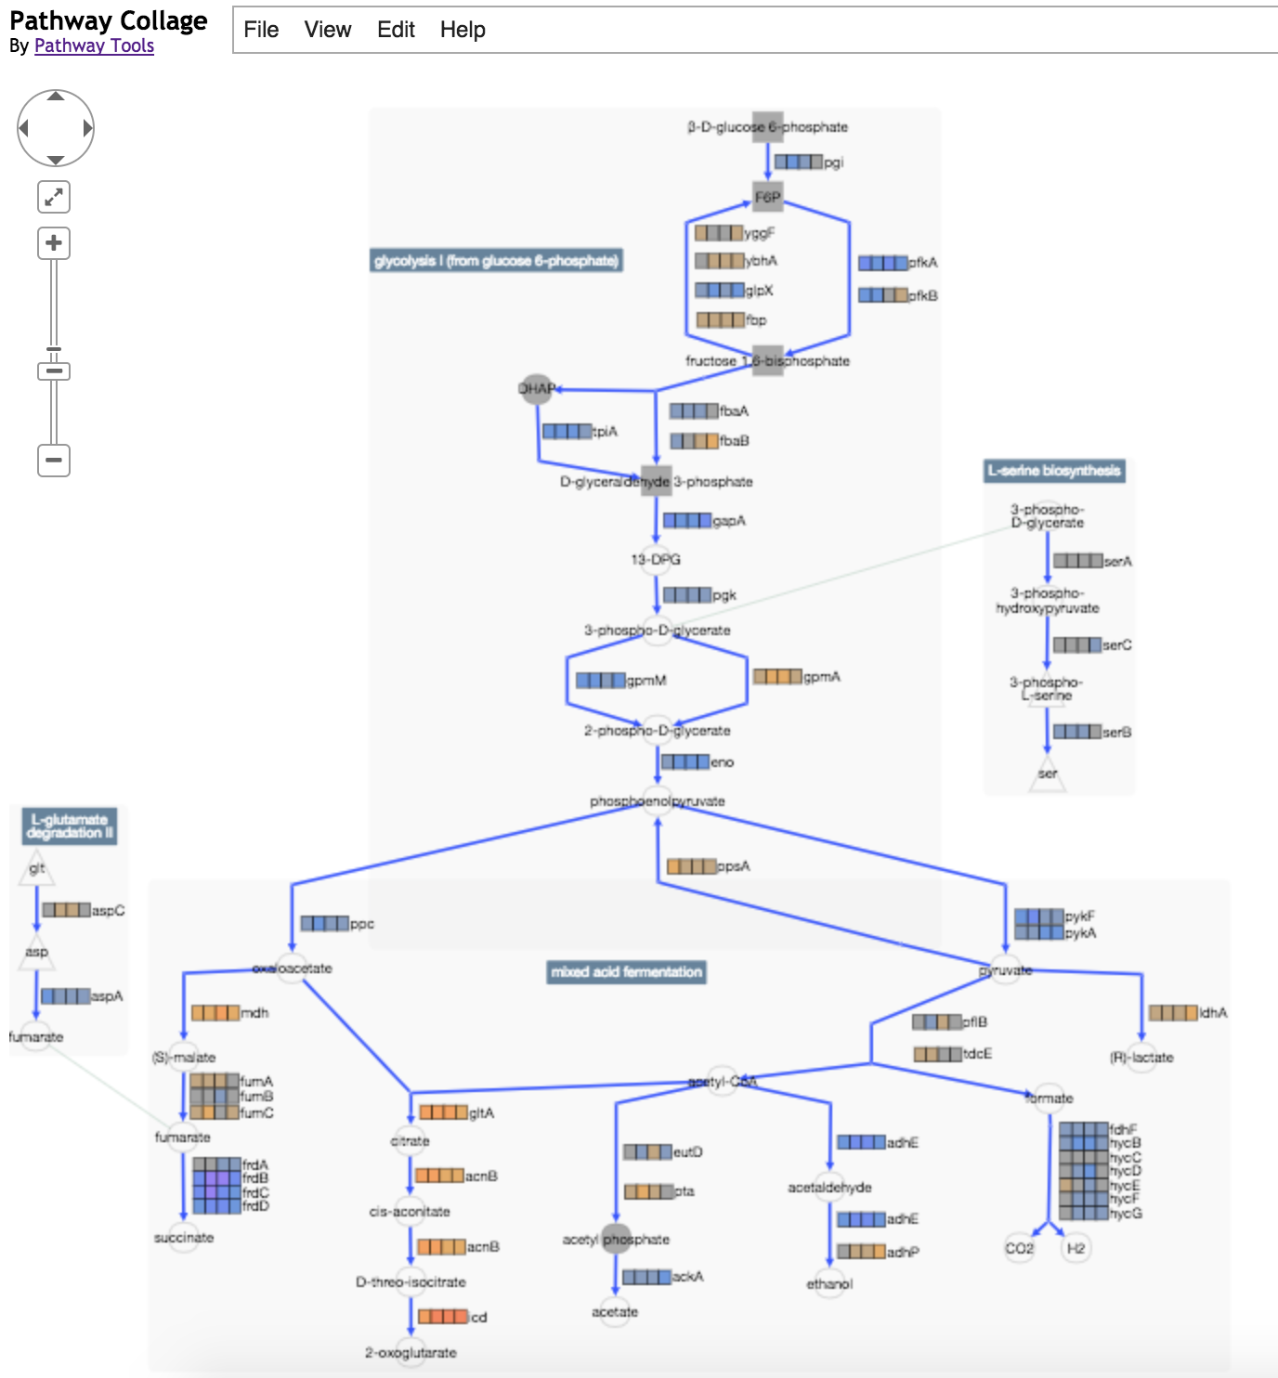

Slide 4
Operations
Adjust position of pathways, metabolites, etc.
Edit labels
Customize appearance of nodes, edges
Show connections between pathways
Merge duplicate metabolites, delete entities
Add pathways involving metabolite
Highlight metabolites, reactions, enzymes of interest
Show/Hide Omics Data
Tooltips provide links to BioCyc/PTools pages
Save/Reload/Export to PNG

Slide 5
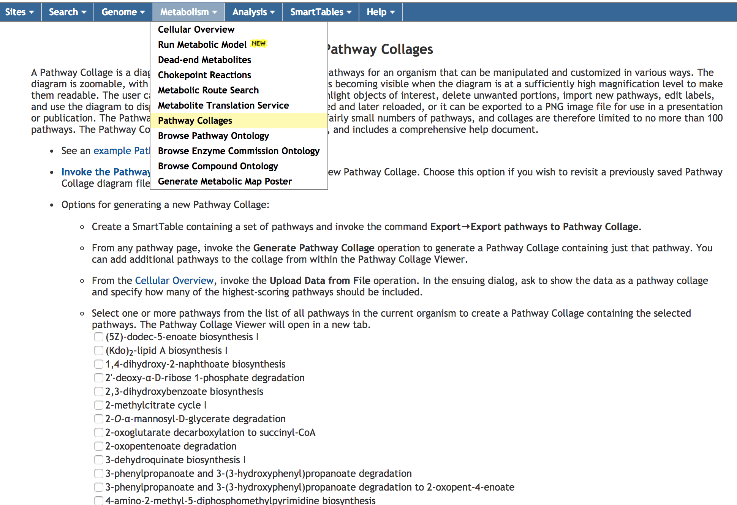
Accessing Pathway Collage App

Slide 6
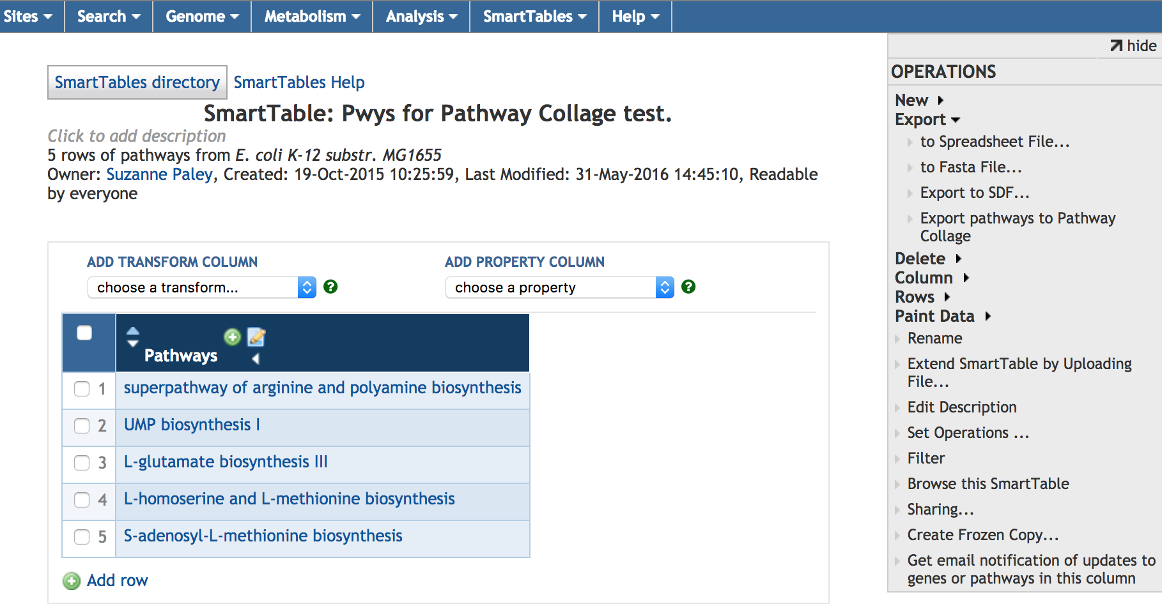
Pathway Collage from a SmartTable

Slide 7
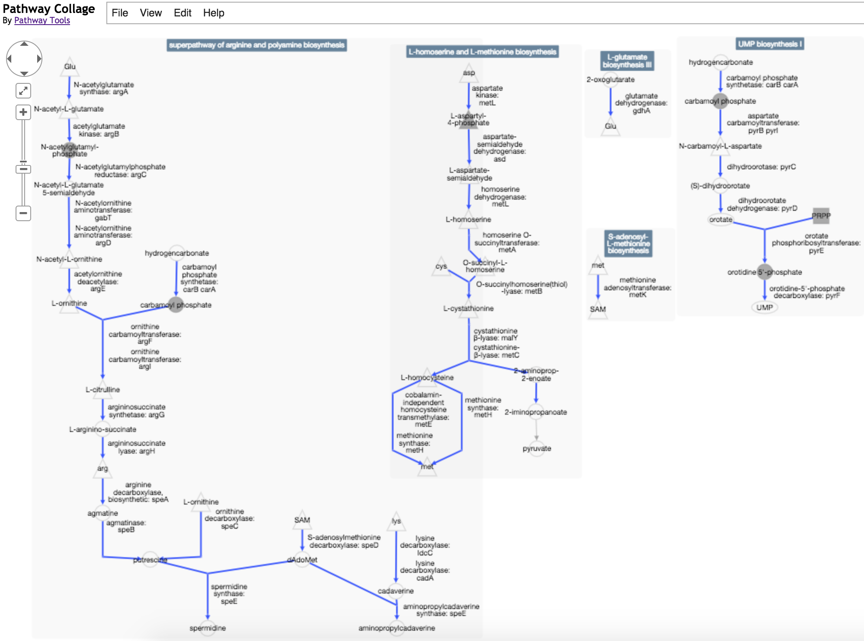

Slide 8
Demo

